Slide 1



Meta Ads Dashboard
View in Power BI
Last data refresh:
07/04/2026 19:17:59 UTC
Downloaded at:
09/04/2026 00:58:40 UTC

Slide 2
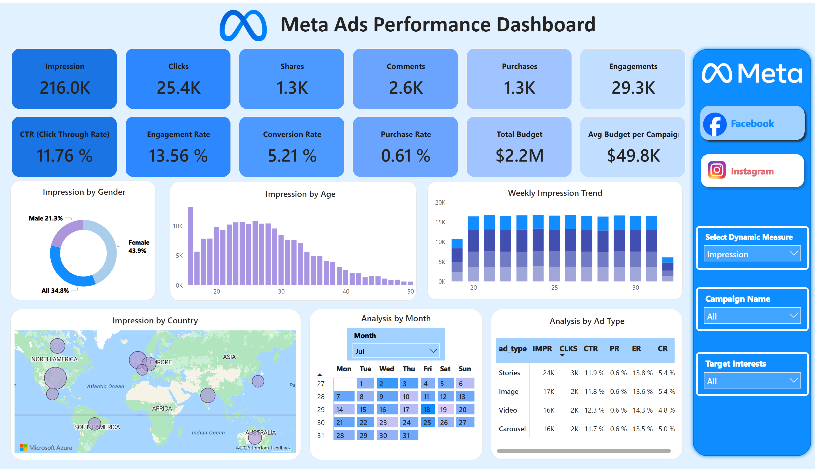
Facebook
Notes:
textbox
No alt text provided
image
No alt text provided
shape
No alt text provided
cardVisual
No alt text provided
image
No alt text provided
cardVisual
No alt text provided
shape
No alt text provided
slicer
No alt text provided
donutChart
No alt text provided
cardVisual
No alt text provided
shape
No alt text provided
columnChart
No alt text provided
cardVisual
No alt text provided
shape
No alt text provided
azureMap
No alt text provided
cardVisual
No alt text provided
shape
No alt text provided
slicer
No alt text provided
pivotTable
No alt text provided
shape
No alt text provided
columnChart
No alt text provided
cardVisual
No alt text provided
cardVisual
No alt text provided
shape
No alt text provided
pivotTable
No alt text provided
cardVisual
No alt text provided
slicer
No alt text provided
slicer
No alt text provided
pageNavigator
No alt text provided
image
No alt text provided
image
No alt text provided

Slide 3
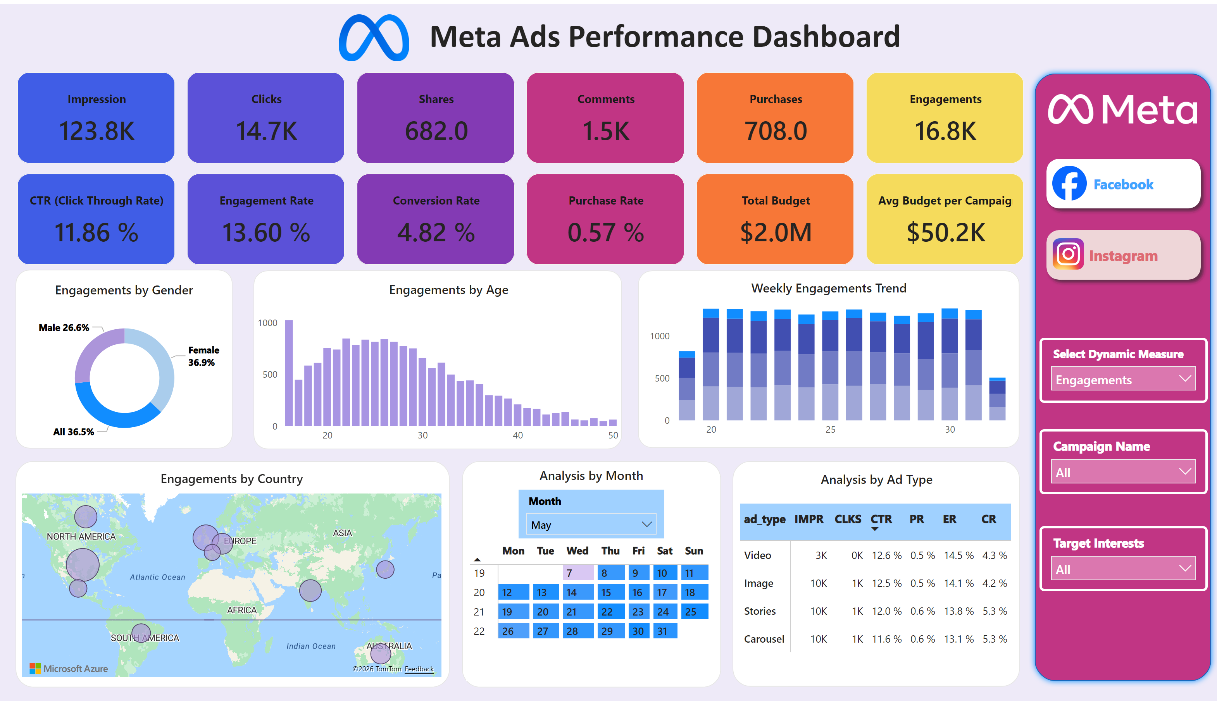
Instagram
Notes:
textbox
No alt text provided
image
No alt text provided
shape
No alt text provided
cardVisual
No alt text provided
image
No alt text provided
cardVisual
No alt text provided
shape
No alt text provided
slicer
No alt text provided
donutChart
No alt text provided
cardVisual
No alt text provided
shape
No alt text provided
columnChart
No alt text provided
cardVisual
No alt text provided
shape
No alt text provided
azureMap
No alt text provided
cardVisual
No alt text provided
shape
No alt text provided
slicer
No alt text provided
pivotTable
No alt text provided
shape
No alt text provided
columnChart
No alt text provided
cardVisual
No alt text provided
cardVisual
No alt text provided
shape
No alt text provided
pivotTable
No alt text provided
cardVisual
No alt text provided
slicer
No alt text provided
slicer
No alt text provided
pageNavigator
No alt text provided
image
No alt text provided
image
No alt text provided

